Slide 1
Musaeus college
Prabhashi Karunathilake-leader
Isuri Mannepperuma
Mayuni Wijesinghe
Ruvindya Perera

Slide 2
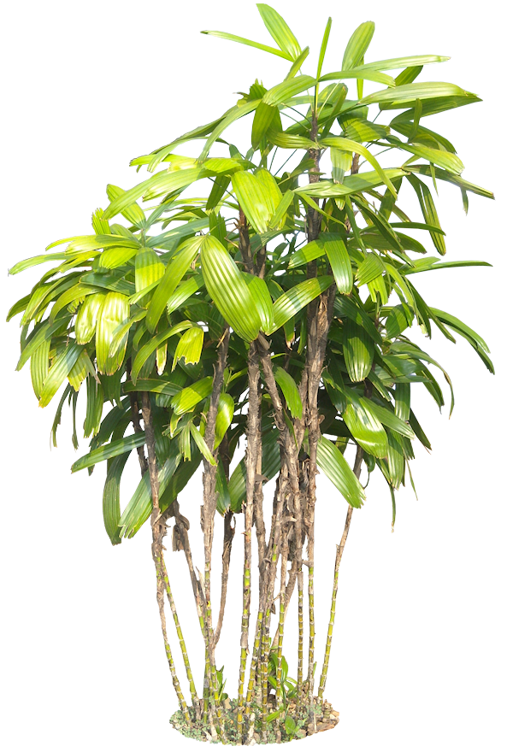
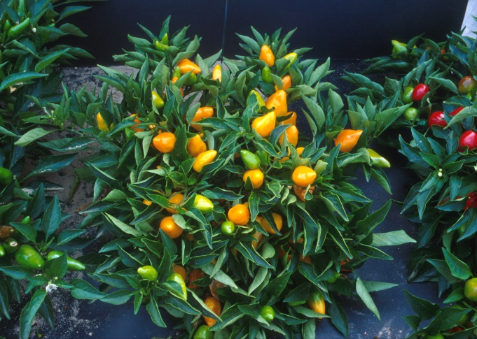
Tourism
Tourism is an essential, an vital source of income to our county
We at Museaus college would like to present you the following solutions to increase tourism in sri lanka
Lets heal the world through our indigenous medicine and traditional therapeutic treatment
Sri lanka is a country which is enriched with medicinal plants , ayurwedic and herbal treatments .
Lets promote to the world that Sri lanka is an excellent country to come to relax and enjoy spiritual healing benefits

Slide 3
2. Developing Entertainment
Even though sri lanka is a country with many natural sights, we are still lacking in the entertainment industry.
Developing more attractive theme parks, better zoos (to let world see our indigenous animals) and installing cable cars. To allow an bigger and picturesque view of our great country

Slide 4
3. Lets make Sri lanka a more safer place
Because of recent terrorist events tourism in Sri lanka has declined vastly.
To increase tourism we think it’s important to make sure that Sri lanka is safe and violence free.
At the same time its necessary to develop the infrastructure of the country to provide a better and more comfortable experience in Sri lanka

Slide 5
Lets bring forward our cultural value
We can promote our cultural and traditional events such as perehara traditional dance clothing, food and bevarages ect.
We should empower people who engage in those activities .
We should promote these by makinf tourists aware about these cultural values.

Slide 6
2. Lets make travelling to sri lanka more easier .
We can use modern technology to advertise our country to the world through various platforms, like creating an official website where any potential tourist can register to receive new information daily

